Slide 1
Microsoft Defender XDR
INTRODUCING

Slide 2
Microsoft Defender XDR:
Microsoft Defender is a unified experience where you can monitor and manage security across your enterprise. With the integrated alerts across identities, endpoints, data, apps, email, and collaboration tools - investigating and responding to threats now happen in a central location.
Microsoft Defender is a unified security platform which Provides threat protection, detection, and response across:
Endpoints
Identities
Email & collaboration
Cloud apps
Cloud workloads

Slide 3
Microsoft Defender XDR Suites
Defender for Endpoint Devices (Windows, macOS, Linux)
Defender for Identity- Active Directory & identity
Defender for Office 365 -Email, Teams, SharePoint
Defender for Cloud Apps - SaaS applications(M365 apps, Zoom, Slack, Salesforce)
Defender for Cloud – VMs, Servers, Cloud Storage across different Cloud Providers(AWS, Azure, Google)

Slide 4
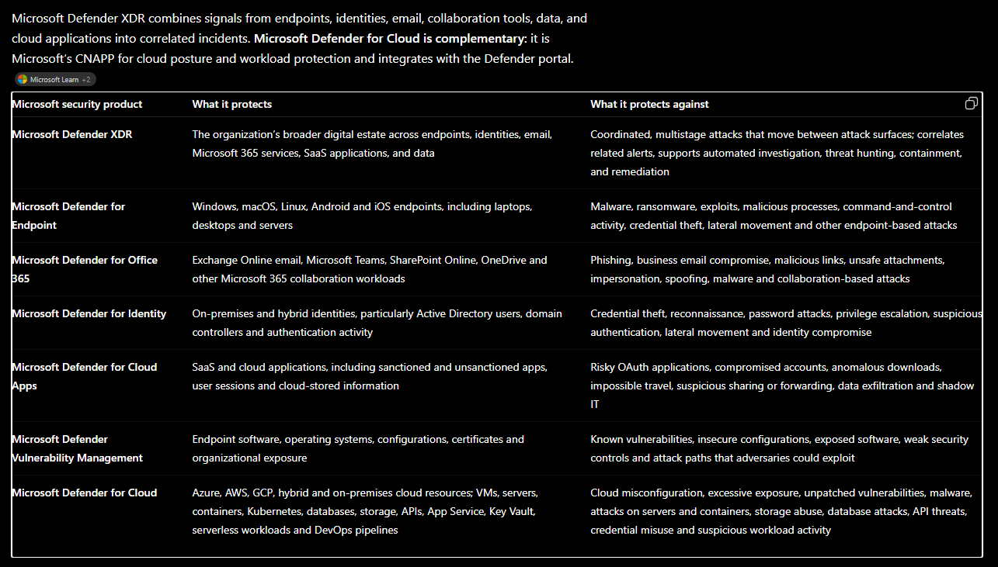
*CNAPP – Cloud-Native Application Protection Platform

Slide 5
Microsoft Defender Portal
The Microsoft Defender portal is Microsoft’s unified security operations console. It gives security teams one place to monitor security posture, review correlated incidents and alerts, investigate threats, run advanced hunting, and take response actions across endpoints, identities, email, applications, cloud workloads, and other connected data sources.
It brings together services such as Microsoft Defender XDR, Microsoft Sentinel, Defender for Cloud, Security Exposure Management, Threat Intelligence, and Security Copilot, helping SOC teams reduce risk and respond to attacks from a single interface.
security.microsoft.com

Slide 6
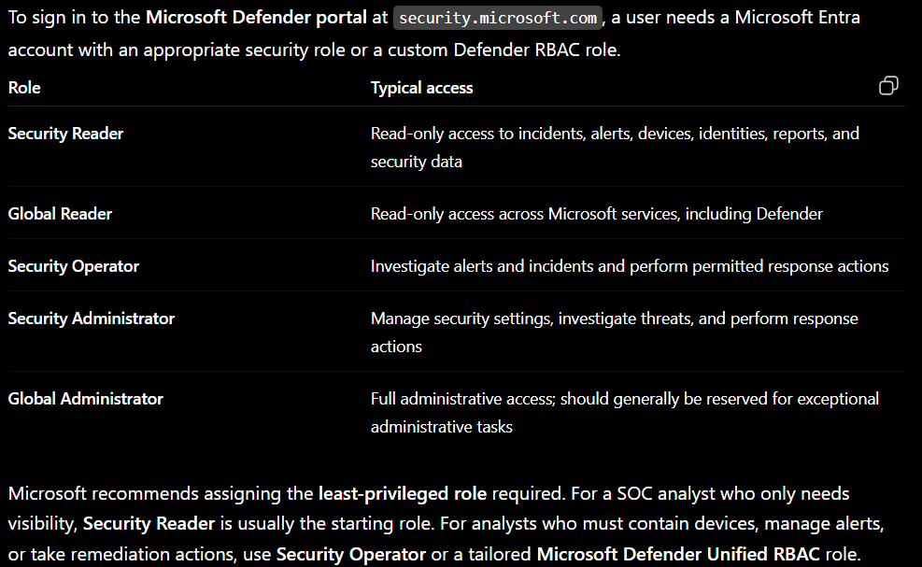
Permissions Needed to Login to MS Defender Portal

Slide 7
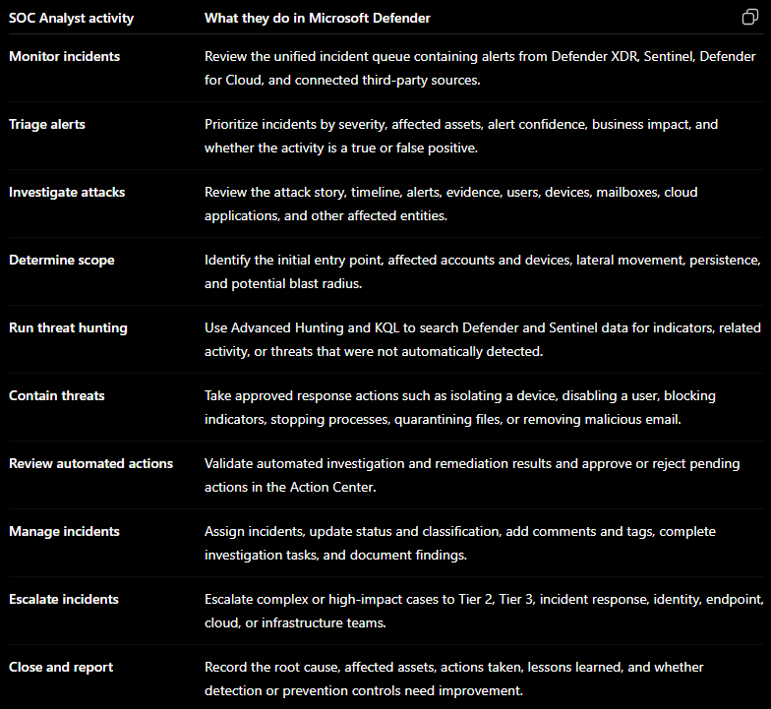

Slide 8
SOC activities in MS Defender Portal
Email Incident Investigations
Endpoint Timeline activity Review
Malware Containment Activity
Threat Hunting
Review of Devices and their Users Activities
Overview of Endpoint recent Security incident
Gain More insight into an MS Defender Incident like “impossible travel”, “malware activity”, “mass file deletion” etc.
Security Operations activities

Slide 9
DEMO

Slide 10
Q&A

